Slide 1

SARFIMA-GARCH Models & Forecasting
Dr. Abolfazl Saghafi
Assistant Professor of Statistics & Data Science
Notes:
This week we combine everything we learned about modeling trend, seasonal variation, and variance heteroscedascity to build a general SARFIMA-GARCH model. We will use some real datasets for modeling.

Slide 2
SARFIMA-GARCH Models
• If residuals don’t have a constant variance, and if the variance is correlated over time, ARCH/GARCH models should be considered for residuals.
After fitting a SARFIMA model to a time series, residuals should verify four assumptions discussed in week 7.
• In this case, residuals don’t have a normal distribution either and have a heavy tail distribution.
• Fitted model is inadequate if autocorrelations still exists in residuals, parameter estimations are unreliable.
• If residuals don’t have a zero mean, a model with include mean should be considered. Parameter estimations are biased.
• In time series where variance changes consistently over time, Box-Cox transformations discussed in week 1 provide a remedy to achieve variance stationarity.
• If residuals don’t have normal distribution, point estimations are valid but confidence intervals and tests are unreliable.
Notes:
When variance changes consistently over time, the situation is called increasing and decreasing volatility. When change of variance happens in a systematic way, the situation is called heteroscedasticity.

Slide 3
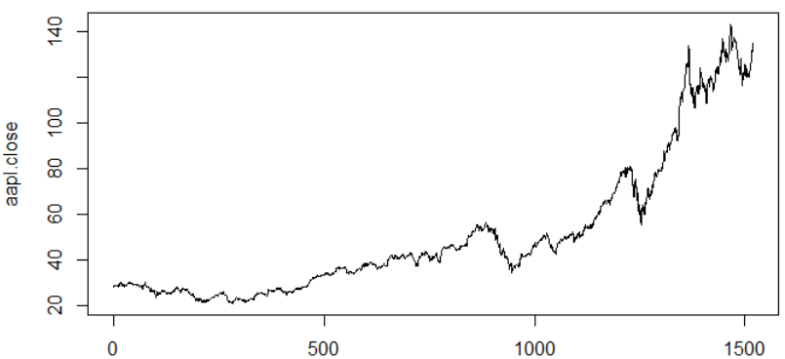
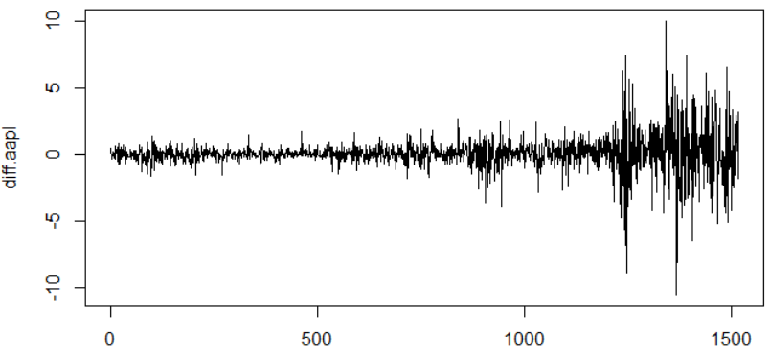
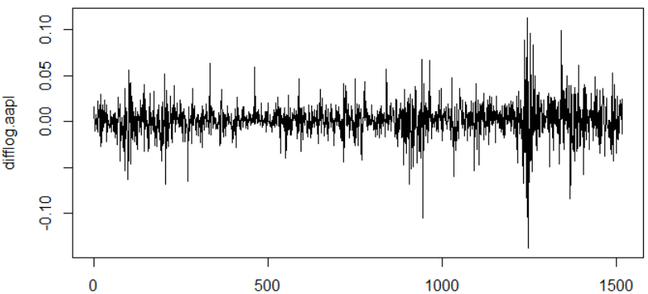

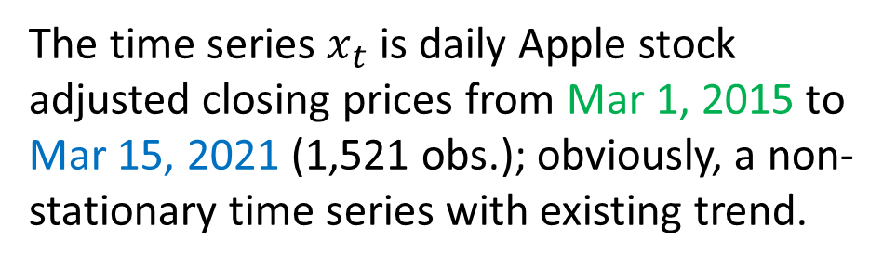


Example 1
$$x_{t}$$
The time series $x_{t}$ is daily Apple stock adjusted closing prices from Mar 1, 2015 to Mar 15, 2021 (1,521 obs.); obviously, a non-stationary time series with existing trend.
$${∇x}_{t}$$
Differencing has removed the trend, but the time series is still non-stationary due to increasing variance with time.
After a log-transformation then differencing, the time series has a better behavior but still is non-stationary due to variance heteroscedascity.
$$r_{t}$$
We can proceed with ARIMA modeling of returns, and then use GARCH models on their residuals to address change of variance and cluster of volatility.
Notes:
People often look at the returns of the stock, rather than the its price. Differences of log prices is known as the returns and represents percentage changes of stock prices.

Slide 4
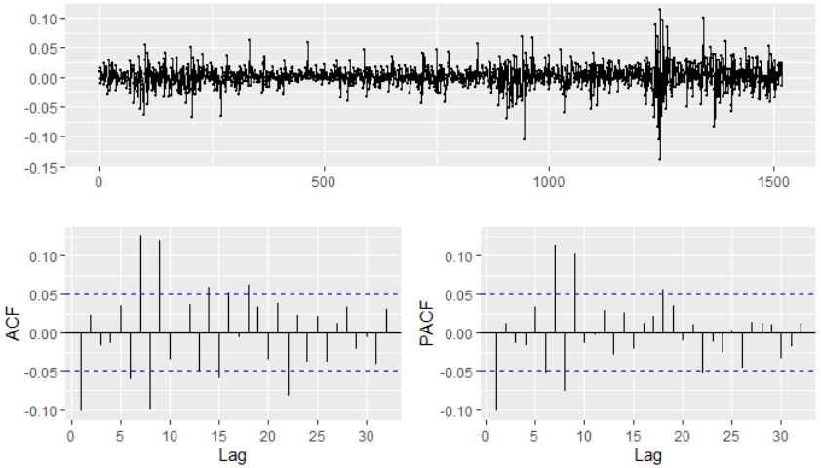
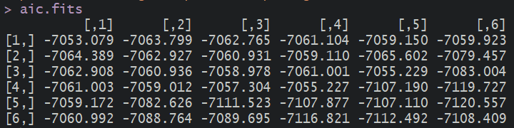
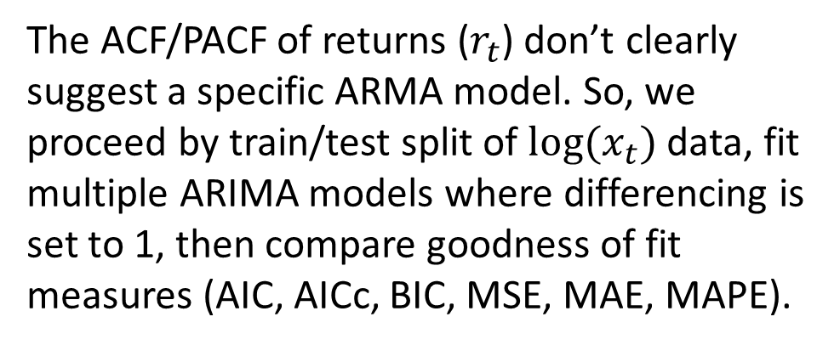
The ACF/PACF of returns ($r_{t}$) don’t clearly suggest a specific ARMA model. So, we proceed by train/test split of $log(x_{t})$ data, fit multiple ARIMA models where differencing is set to 1, then compare goodness of fit measures (AIC, AICc, BIC, MSE, MAE, MAPE).
ARIMA(4,1,2) performs better than alternative models and has a smaller number of parameters. It will be used for parameter estimation.
Model AIC (p+q)
ARIMA(4,1,5) -7120.6 9
ARIMA(3,1,5) -7119.7 8
ARIMA(5,1,3) -7116.8 8
ARIMA(4,1,2) -7111.5 6
AICc BIC
-7116.4 -7061.6
-7115.6 -7065.7
-7112.7 -7062.8
-7107.4 -7067.5
MSE MAE MAPE
0.022 0.137 0.0287
0.019 0.124 0.0259
0.020 0.129 0.0269
0.008 0.077 0.0161

Slide 5
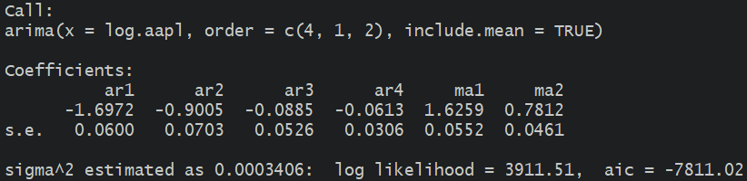
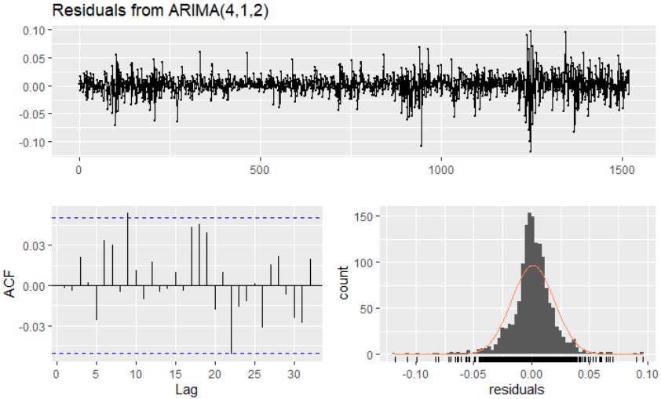
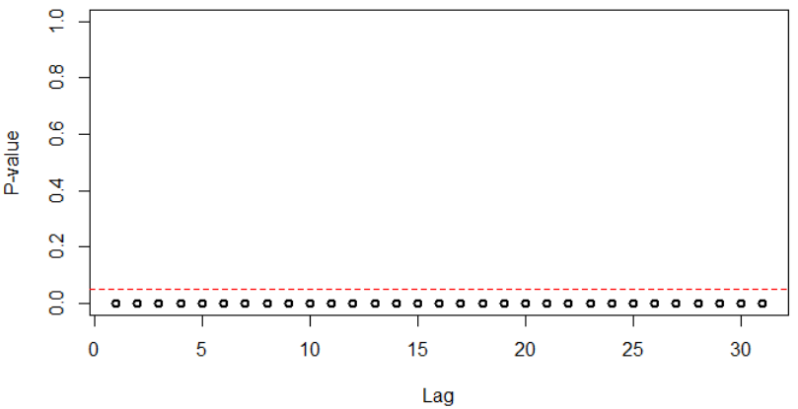
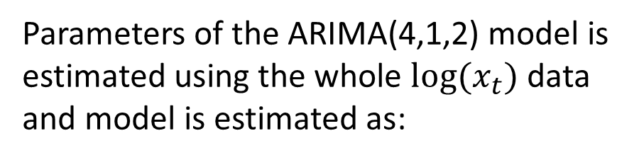
Parameters of the ARIMA(4,1,2) model is estimated using the whole $log(x_{t})$ data and model is estimated as:
$$\left(1−1.7B−0.90B^{2}−0.09B^{3}−0.06B^{4}\right)\left(1−B\right)\log{x_{t}}=\left(1−1.63B−0.78B^{2}\right) ε_{t}$$
Moving on with residual analysis, there seems to be no serial correlation left in the residuals (1), their distribution is not normal and has heavy tails (2), their mean in nonzero (3), and their variance is non-constant (4).
Clusters of volatility is confirmed using McLeod-Li test.
Notes:
I have multiplied MA coefficients by -1 since my MA model identification discussed in week 4 was introduced that way. In the video, the parameters of the AR part were mistakenly set as positive numbers; it has been fixed here.

Slide 6
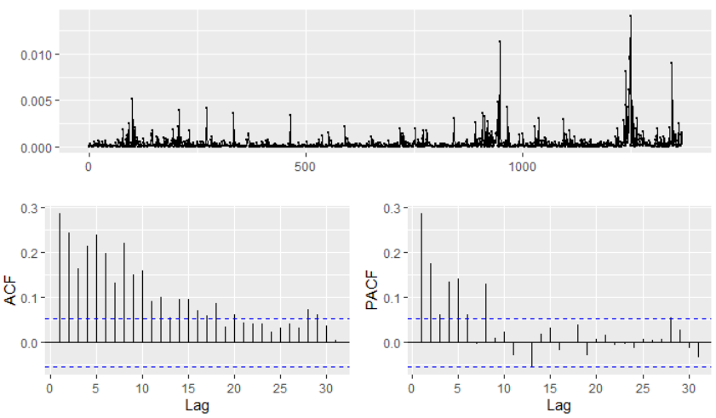
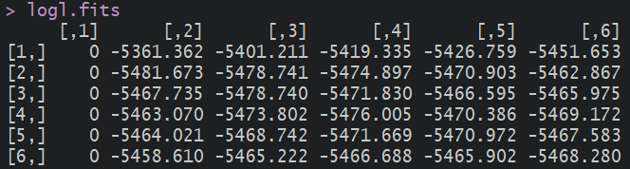
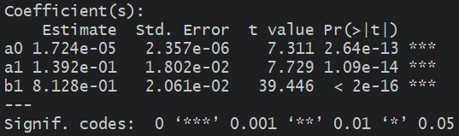
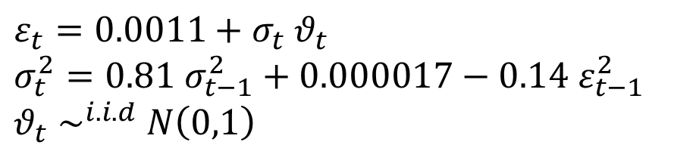
We proceed by investigating squared residuals. Volatility clusters is evident from the time plot, ACF/PACF don’t clearly suggest a specific ARCH/GARCH model.
After fitting multiple ARMA models to the squared residuals, GARCH(1,1) had the smallest -loglikelihood and is selected as the best model.
Fitting the model results in the following estimation for the residuals:
$$ε_{t}=0.0011+σ_{t} θ_{t}$$
$$σ_{t}^{2}=0.81 σ_{t−1}^{2}+0.000017−0.14 ε_{t−1}^{2}$$
$θ_{t}$ $\sim ^{i.i.d} N\left(0,1\right)$
Notes:
Follow the R session to see the codes and details of these calculations.

Slide 7
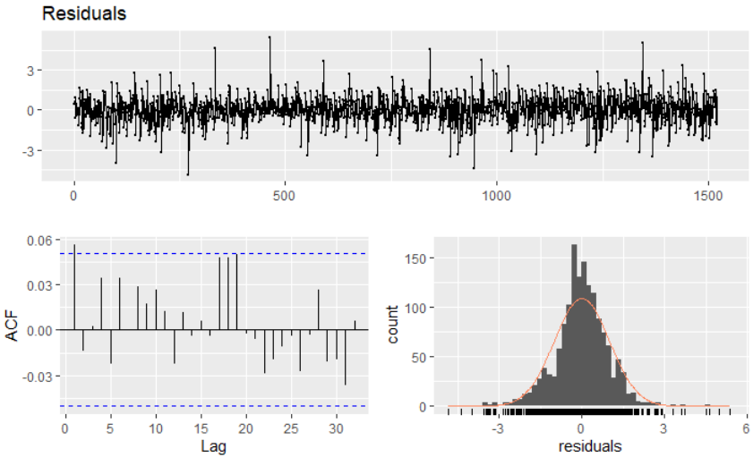
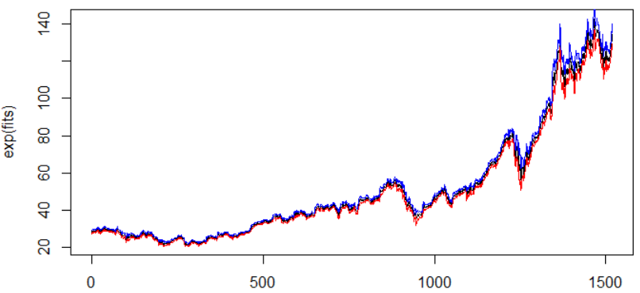
Residuals after the GARCH fit confirm all assumptions except for normality but the histogram shows a normal pattern. So, we decide to go with normal assumption.
We continue by forecasting the Apple adjusted closing price for next day (16 Mar 2021) as 134.45 with 95% low & upp of 129.58 & 139.50. The confidence level of intervals will not be 95% since normality assumption was questionable.
From the plot of model fitted values and their predicted low & upp boundaries you can see how change of volatility is affecting the prediction values.

Slide 8
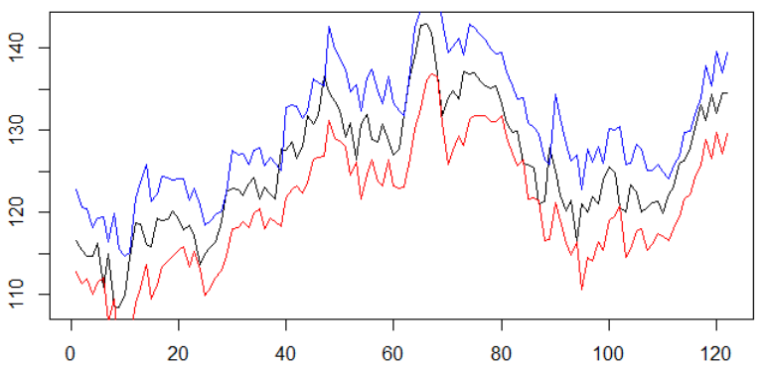
Plot of the original daily stock values since 10/21/2020 and the forecasted value on March 16th (black) with predicted 95% lower (red) and upper (blue) boundaries.
You can see that the predicted values using fitted ARIMA-GARCH model has nicely enclosed the original values. This is a good indicator of the model performance.
Notes:
The 95% confidence bounds are generated using fitted ARIMA-GARCH model, they are enclosing the original tock market prices, that shows that the model is performing very well.

Slide 9
Practice Problems
1. Provide a model to forecast weekly crude oil spot prices. Data is available after running library(astsa) and data(oil) in R [3].
2. Run data(EuStockMarkets) in R to have acquire daily closing prices of four major European stock indices. Fit a model to of one of the closing prices and provide future forecast for next day.
3.
[3] Shumway & Stoffer, Time Series Analysis and Its Applications with R Examples, 4th Edition, Springer, 2017.

